Slide 1
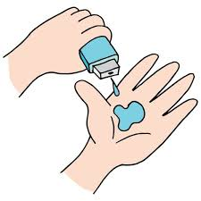
Project Title -Seasonal Agriculture Performance Analysis
Student Name – Farhan Firoz Sayyed
College Name- St. Andrew’s college of science , arts & commerce
AICTE STU ID-:
STU676e36babf3a31735276218

Slide 2

PROBLEM STATEMENT
(Agricultural activities are influenced by seasonal variations in environmental conditions, farming practices, resource availability and market conditions. As a result, agricultural performance may differ from one season to another. However, raw agricultural data does not clearly explain how agricultural performance changes across seasons or what patterns can be observed in different seasonal conditions. The problem is to analyze the given agricultural dataset and investigate seasonal differences in agricultural performance by identifying meaningful patterns, trends, relationships and variations within the available data.

Slide 3
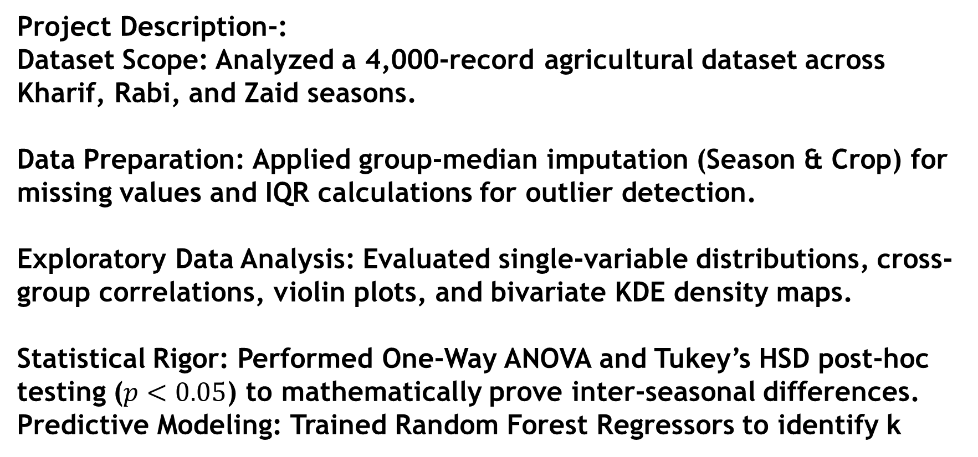
Project Description-: Dataset Scope: Analyzed a 4,000-record agricultural dataset across Kharif, Rabi, and Zaid seasons. Data Preparation: Applied group-median imputation (Season & Crop) for missing values and IQR calculations for outlier detection. Exploratory Data Analysis: Evaluated single-variable distributions, cross-group correlations, violin plots, and bivariate KDE density maps. Statistical Rigor: Performed One-Way ANOVA and Tukey’s HSD post-hoc testing ($p<0.05$) to mathematically prove inter-seasonal differences. Predictive Modeling: Trained Random Forest Regressors to identify k

Slide 4

WHO ARE THE END USERS?
Agricultural Policy Makers: To design regional water harvesting initiatives and seasonal crop subsidies.
Farm Owners & Agronomists: To optimize crop selection, fertilizer application, and irrigation schedules.
Supply Chain & Agri-Tech Companies: To forecast seasonal harvest volumes and mitigate financial risks.

Slide 5

Technology Used
Language & Environment: Python 3.x, Google Colab / Jupyter Notebook
Data Processing: Pandas, NumPy
Visualization: Matplotlib, Seaborn
Statistics & ML: SciPy, Statsmodels, Scikit-Learn (RandomForestRegressor)

Slide 6
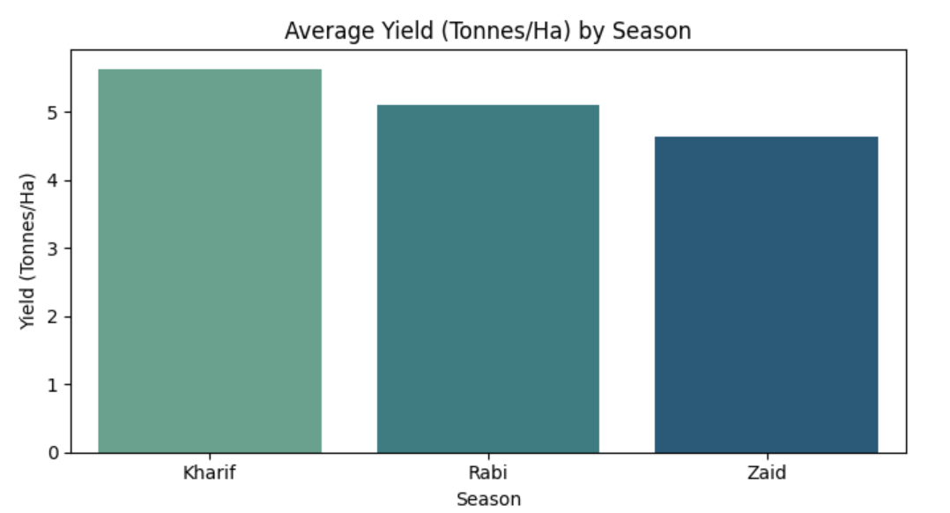
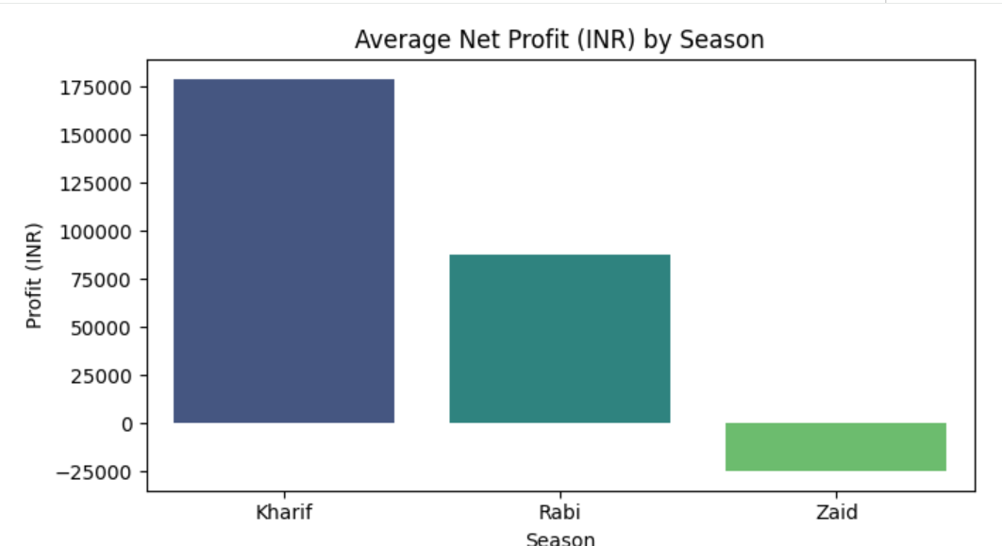
RESULTS

Slide 7
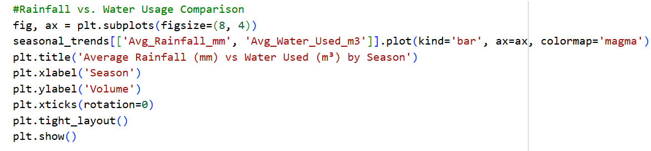
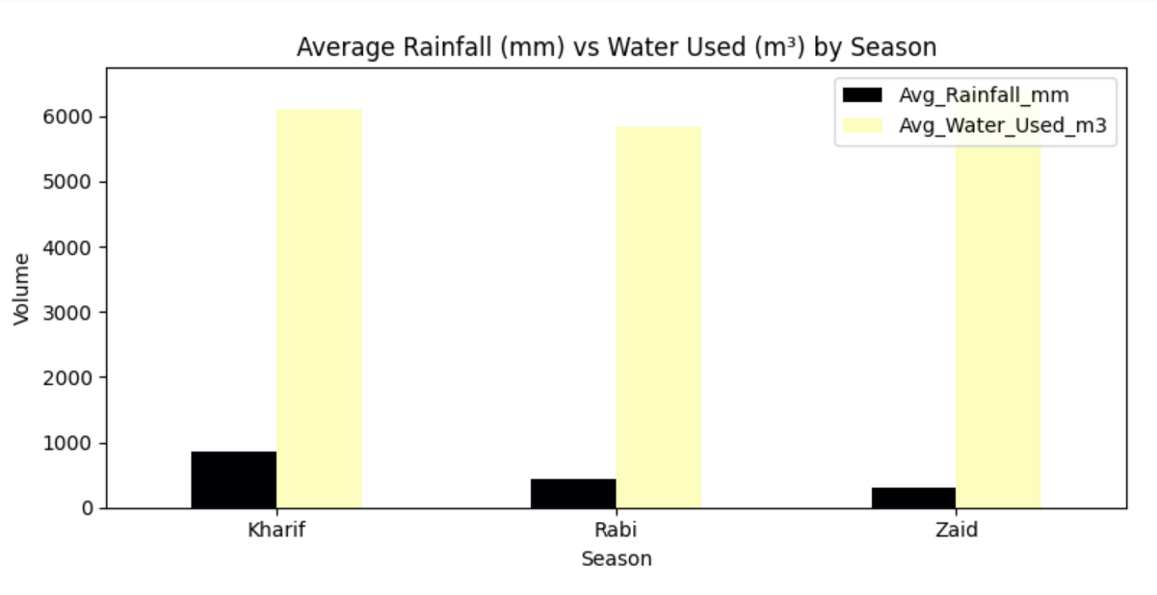
RESULTS

Slide 8
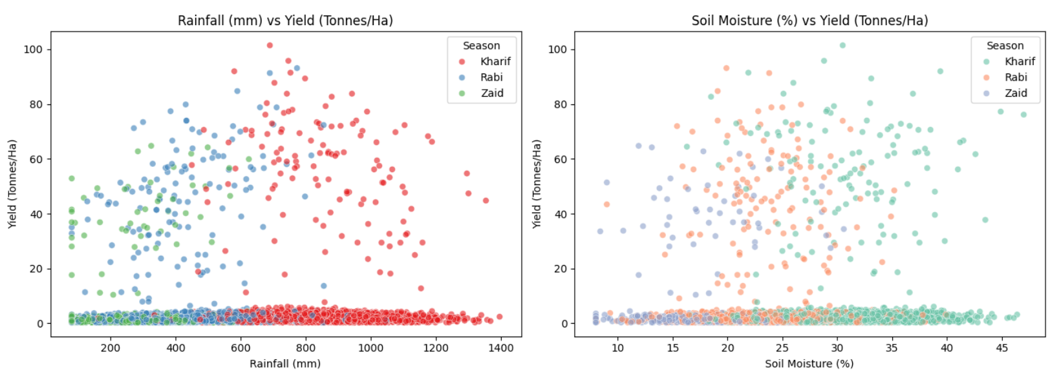
RESULTS

Slide 9
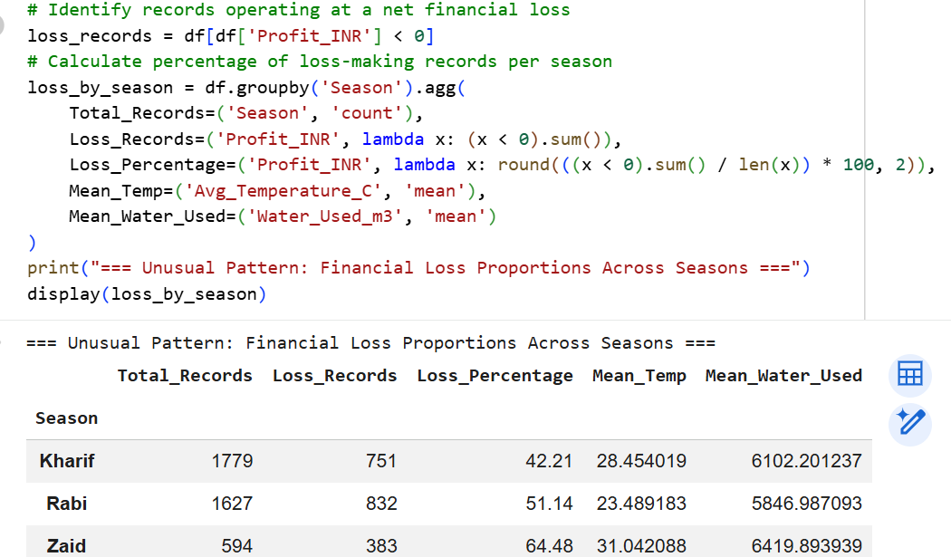
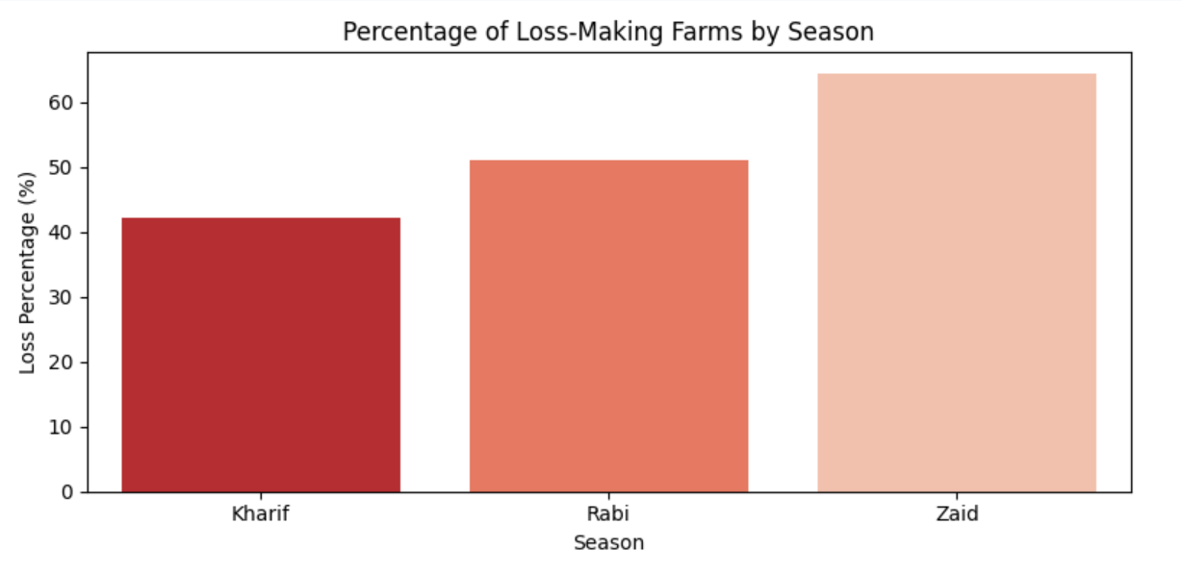
RESULTS

Slide 10
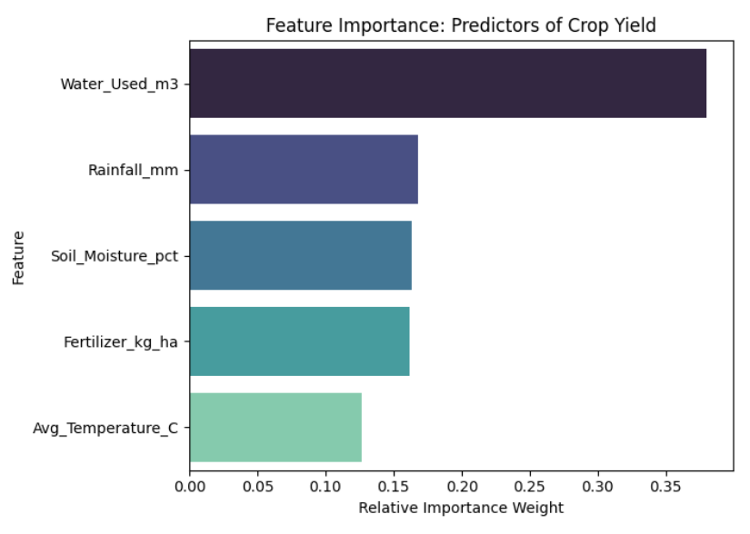
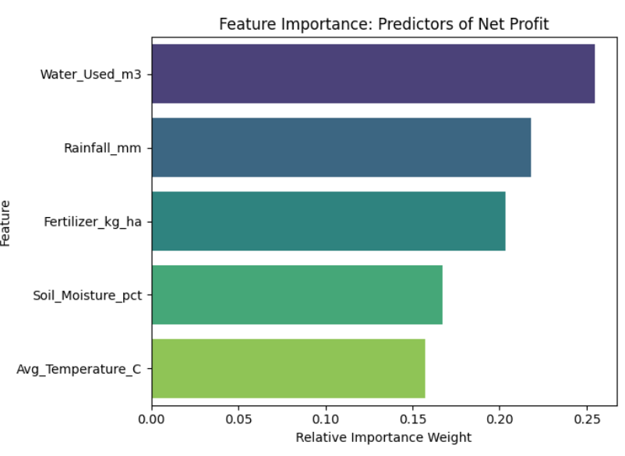
RESULTS

Slide 11
Future scope
IoT Integration: Incorporate real-time soil and weather sensors for dynamic automated irrigation.
Geospatial Analysis: Implement GIS and satellite imagery for regional crop health tracking.
Predictive Time-Series: Train deep learning models (LSTM/Prophet) to forecast long-term multi-year yields under changing climate conditions.

Slide 12
GitHub Link
https://github.com/officialfarhansayyed-prog/Seasonal_Agriculture_Performance_Data_Analysis

Slide 13

VOIS Course completion certificate - Course name- Data Visualization

Slide 14
Thank you
.
.

